Slide 1
Data Lake Project
Data lake of Youtube Comments
Student: Mohamed Sabkhi
Class: 2IDSD1

Slide 2
Dataset source
The Dataset was scraped using the youtube API.
The dataset was uploaded to kaggle by NIPUN ARORA.
Link of the dataset: most liked comments on youtube

Slide 3
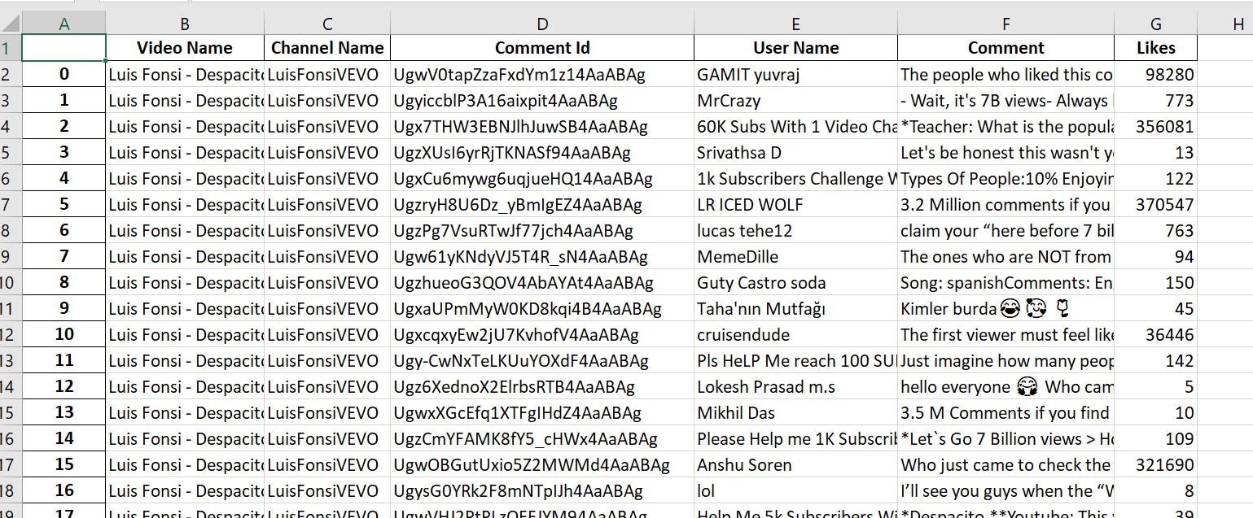
Youtube Comments Dataset preview:

Slide 4
Youtube Comments dataset Columns:
Video Name: Name of the video from which the comment was extracted
Channel Name: Name of the channel from which the video was uploaded
CommentID: unique identifier of the comment.
User name: user name of the commenter.
Comment: the text comment
Likes: number of likes on the comment.

Slide 5
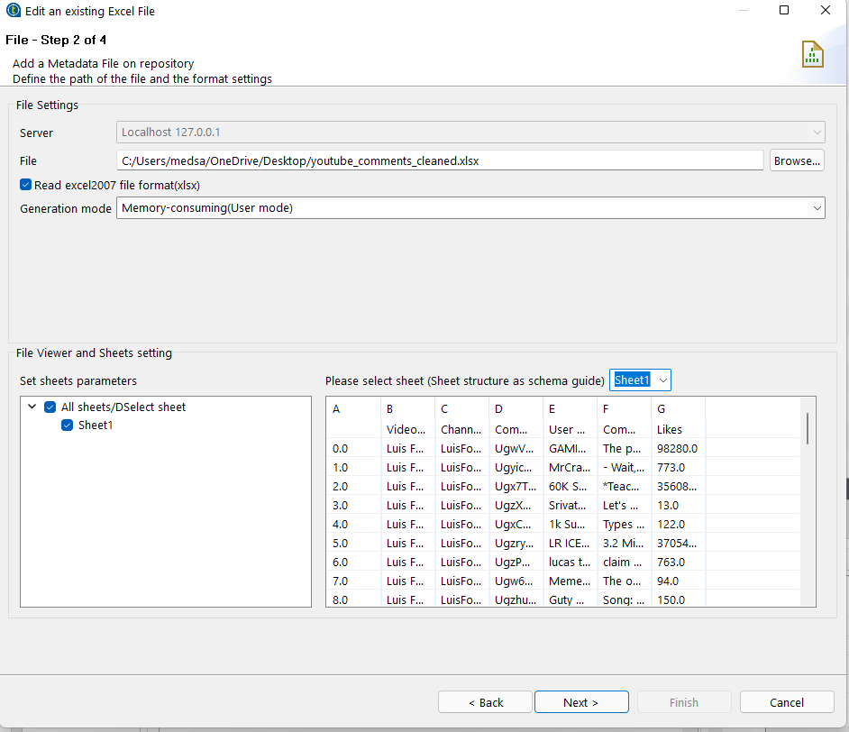
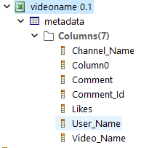
Loading Excel sheet into talend

Slide 6
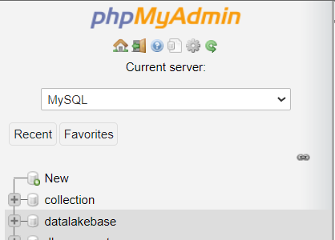
Creating MySQL database using phpmyadmin
Databasename: datalakebase

Slide 7
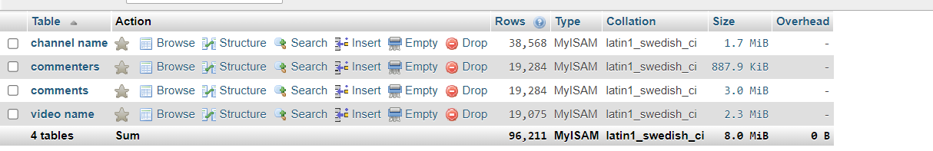
Creating tables in mysql database.

Slide 8
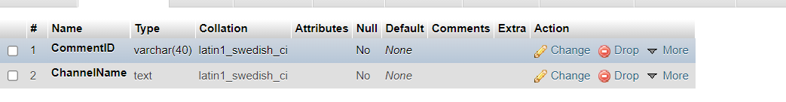
Table 1: channelname

Slide 9
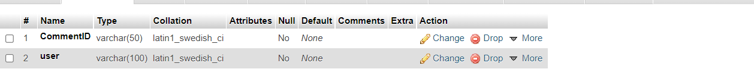
Table 2: commenters

Slide 10
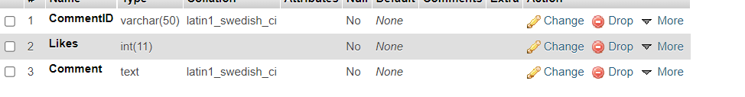
Table 3: comments

Slide 11

Table 4: video name

Slide 12
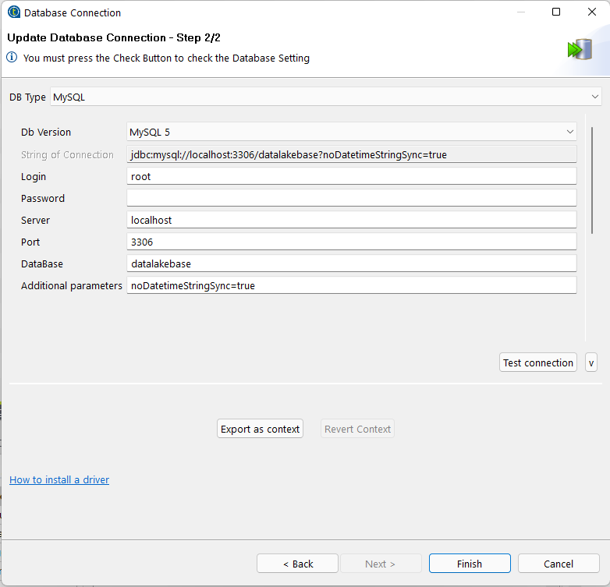
Establishing connection with Mysql database

Slide 13
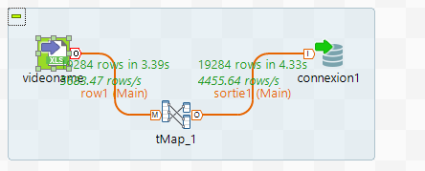
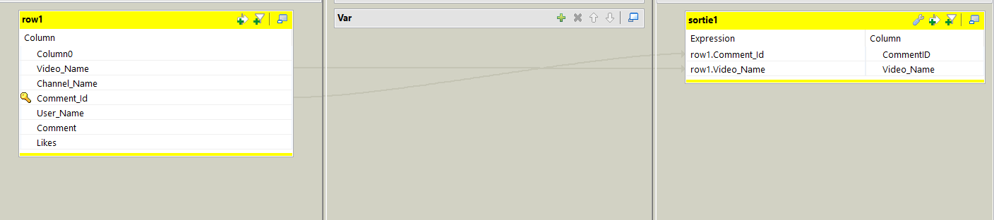
Creating jobs for each table:
Job1:

Slide 14
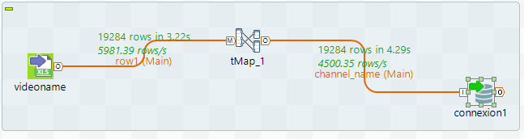
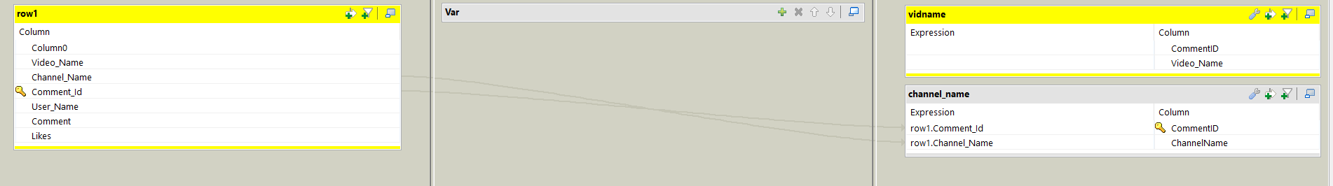
job2:

Slide 15
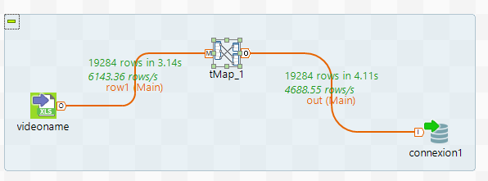
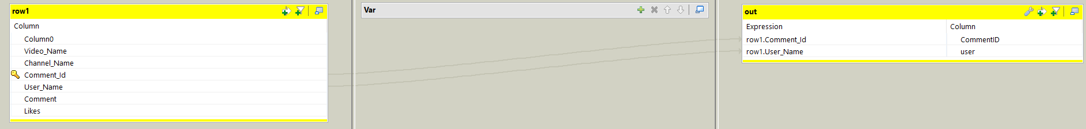
job3:

Slide 16
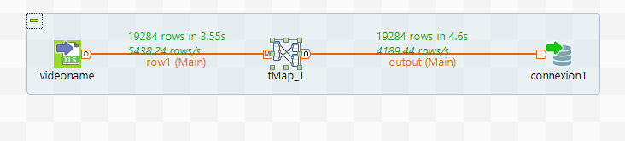
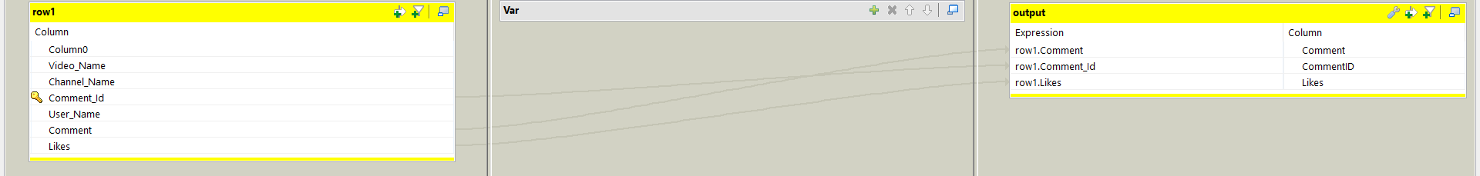
job4

Slide 17
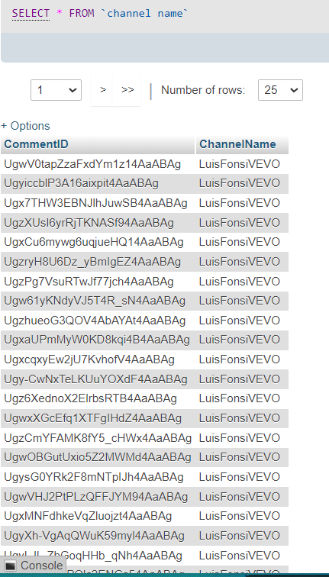
Checking database:
Table: Channel name

Slide 18
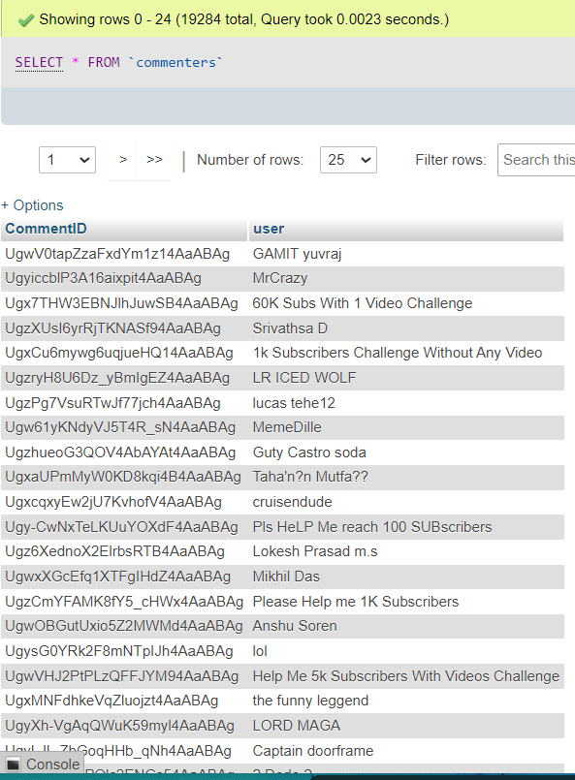
Table: commenters

Slide 19
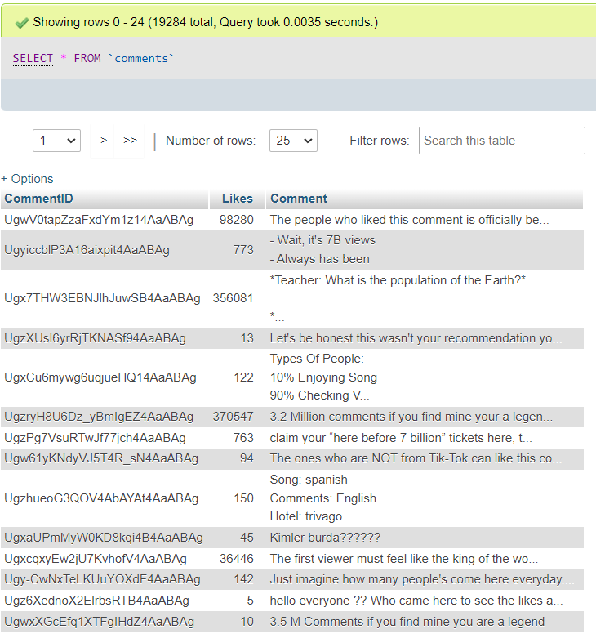
Table: comments

Slide 20
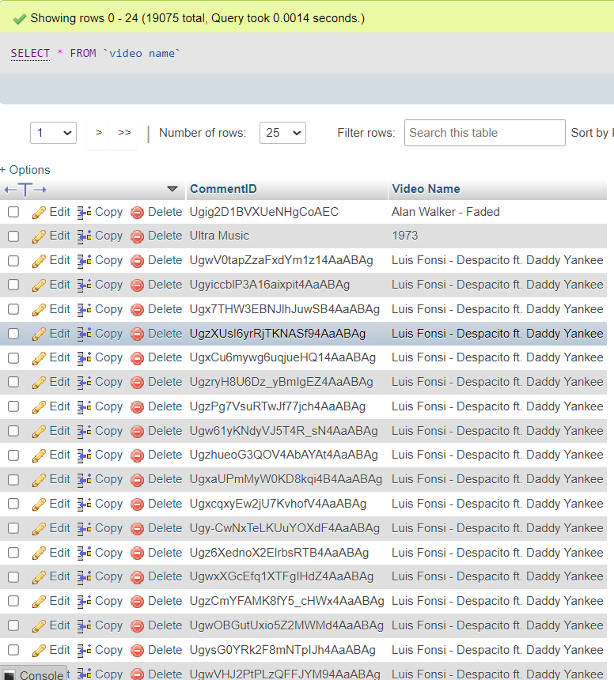
Table video name:

Slide 21
Thank you for viewing my work!

